Slide 1
NBA GAME PREDICTIONS
Levi Christian
James Pak
William Udeh
April 28, 2021

Slide 2
Motivation For Project
Will Geoghegan’s AdaBoost model was all the rave this year when it registered at top 0.2% among +14M NCAA tournament brackets on ESPN, accurately predicting the outcome of all but a couple games (i.e., Oral Roberts vs. UCLA, Alabama vs. UCLA).
This amazing accomplishment served as motivation for our project thus we endeavored to achieve similar results across the remainder of the NBA season by developing a machine learning model that attempts to accurately predict the outcome of game matchups.

Slide 3
key project considerations
Learning Model Selection: Supervised, Unsupervised, Reinforcement.
Data source, structure, quality & quantity
Feature Selection and Engineering
Notes:
To achieve this we had to make sure that we hit the mark on several key objectives:
supervised, unsupervised, reinforcement, etc. & the associated subcategories (i.e., regression, clustering, etc.)
Data source, structure and depth: Where is the data going to come from, unstructured or structured & how much historical data was needed to accomplish our goal
Selecting the right Feature engineering techniques: As you might imagine the data for this type of project would likely be unstructured therefore we had to consider how we would structure our df in order to convert it into meaningful data that we could make effective use of
Our data contains team game stats over the past 6 years, sourced from the official NBA website team. The targeted features for our model are FG%, 3PFG%, 3PA, FGA, FT%, wins/loss record, team ranking, etc.

Slide 4

Data & feature selection
NBA team stats for past 10 years sourced from https://www.nba.com/stats/teams/boxscores/
32 targeted features for our models: FGA, 3PA, FT%, Reb, Asst., Steals W/L results, etc.
Libraries: Sklearn, tensorflow, numpy, pandas

Slide 5
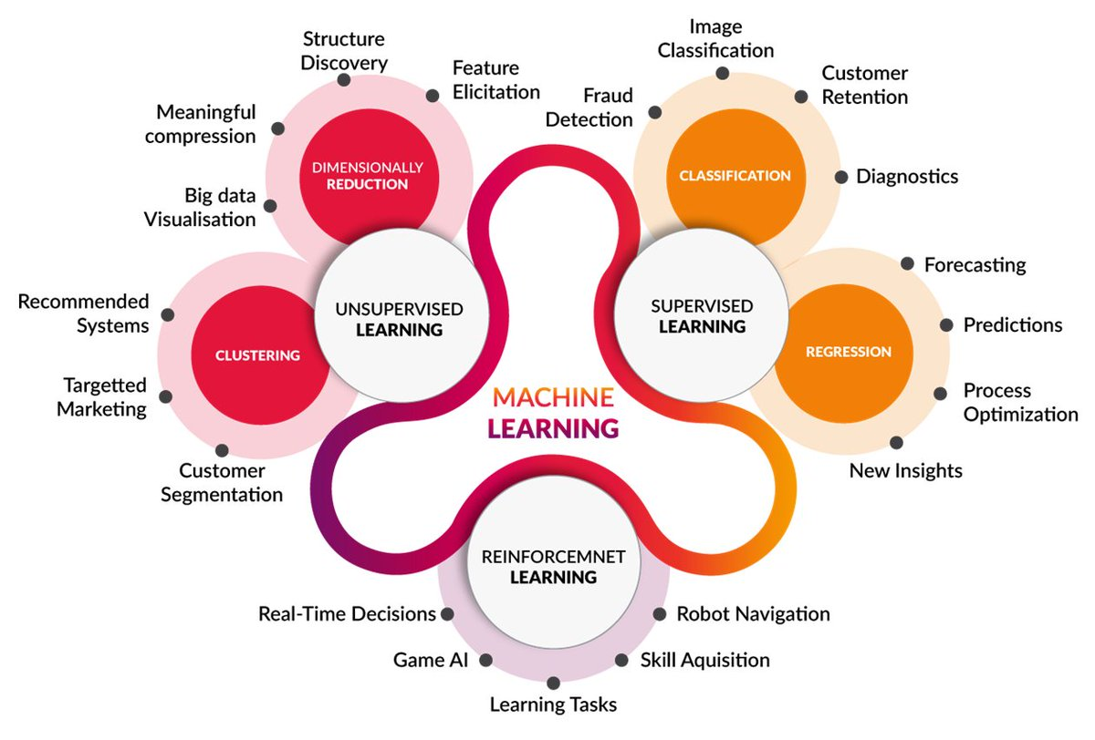
Notes:
Among the various models we thought we’d narrow our focus to unsupervised & supervised models of which we tested 2 & 3 layer rnn lstm neural network, adaboost, gradiant boosting, random forest.

Slide 6
Random forest
Nba game PREDICTIONS

Slide 7
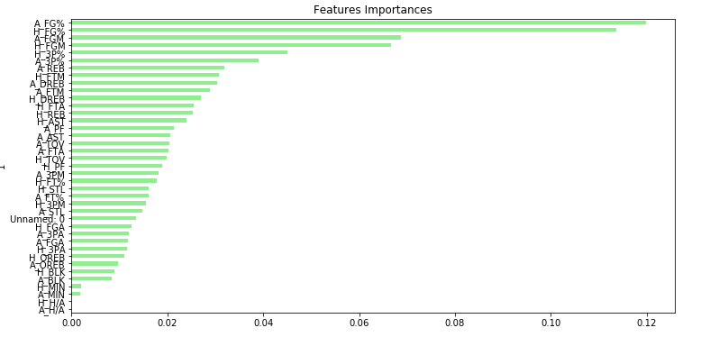
Random forest top features

Slide 8
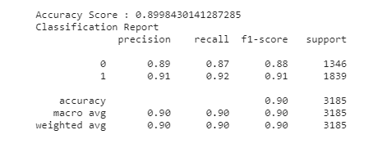
Random forest results

Slide 9
Neural network
Nba game PREDICTIONS

Slide 10
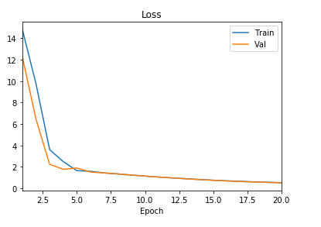
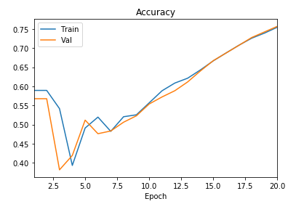
Neural network

Slide 11
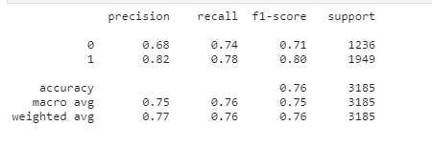
Neural network results

Slide 12
Postmortem
For our purposes and due to the development timeframe, we thought it would be better to procure team data rather than player data which would require considering injuries, player efficiency rating, trades, etc. Although it would increase complexity it would likely help improve accuracy and provide feedback that would be beneficial for point spread gambling, taking advantage of odds with high payouts.

Slide 13
Questions??

